Slide 1


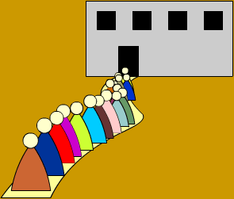
Computer Networks Performance Evaluation

Slide 2
Chapter 11
Single Queue Systems
Performance by Design:
Computer Capacity Planning by Example
Daniel A. Menascé, Virgilio A.F. Almeida, Lawrence W. Dowdy
Prentice Hall, 2004

Slide 3

Outline
11.1. Introduction
11.2. Single Queue Single Server Systems
11.3. The M/M/1 Queue
11.4. The M/G/1 Queue
11.5. M/G/1 with Vacations
11.6. M/G/1 with Priorities
11.7. Approximation Results
11.8. Concluding Remarks
11.9. Exercises
Bibliography

Slide 4
In this chapter:
This chapter explores some important classical analytic results for single queue systems.
Examples of queuing stations discussed in this chapter include:
  1) a single waiting line and a single server
  2) multiple waiting lines (arranged by priority) and a single server
  3) a single waiting line and multiple servers

Slide 5
Components of a Queuing System-Arrival Process
Arrival Process (inter-arrival time)
  Ai denotes the time interval between the arrival of the (i - 1)st and i th customer.
  Assume that the successive times A1, A2, …, An are Independent Identically Distributed (i.i.d.) random variables.
  λ = 1/E(A) the arrival rate of the customers (reciprocal seconds).
  Notice that giving an arrival rate is not sufficient. It needs to give a probability distribution, for which the arrival rate will provide the mean - or the reciprocal of the mean. Unless specified, though, we usually mean an exponential distribution with given mean.

Slide 6
Components of a Queuing System-Service Mechanism
Service Mechanism.
  This is specified by variable S, and the probability distribution of the service times.
  S1, S2, …, Sn are i.i.d. random variables giving the service times of a sequence of customers.
  W = 1/E(S) stands for the service rate of a server.

Slide 7
Components of a Queuing System-Queue Discipline
Queue Discipline.
  This is the rule by which we choose the next customer to be served. Examples
    FIFO: First In First Out (a standard queue)
    LIFO: Last In First Out (a stack)
    Priority: some way is defined to determine the priority of a customer (a priority queue)

Slide 8
Number of Servers
Arrivals
Dispatching
discipline
Queue
Server
Departures
Single Server systems
Xo departure rate
λ arrival rate
Server
1
Dispatching
discipline
Arrivals
Server
2
Departures
Multi-server systems
Queue
λ arrival rate
Xo departure rate
Server
N
Queue1
Server
1
Multiple Single Servers systems
Arrivals
Server
2
Departures
Queue2
λ arrival rate
Xo departure rate
QueuenN
Server
N

Slide 9
Kendall Notation of Queuing Systems (1)
X / Y / Z / K / C / Z
dispatching discipline
stochastic process of arrivals
total number of customers
stochastic process of service time
the queue capacity
number of servers

Slide 10
X/Y/…
Markov
Processes
X indicates the nature of the arrival process:
  M : Memoryless (= Poisson process, exponentially distributed interarrival times).
  G : General distribution of interarrival times.
  D : Deterministic interarrival times.
Y indicates the probability distribution of the service times:
  M : Exponential distribution of service times.
  G : General (arbitrary) distribution of service times.
  D : Deterministic distribution of service times.
Birth-death
Processes
Poisson
Processes

Slide 11
X/Y/Z/K/…
Z indicates the number of servers .
K (optional) indicates the limit on the number of customers in the system.
  omitted if infinite .
Examples:
  M/M/1, M/M/m, M/M/∞, M/M/m/m
  M/G/1, G/G/1
  M/D/1, M/D/1/m

Slide 12
Variables for All Queues
τ = interarrival time
λ = mean arrival rate = 1/E[τ]
  Can sometimes depend upon jobs in system
S = service time per job
μ = mean service rate per server = 1/E[S], total rate mμ
N_{q} = number of jobs waiting in queue
N_{s} = number of jobs receiving service
N = number of jobs in system = N_{q} + N_{s}
R = response time
w = waiting time
Previous
Arrival
Begin
Service
End
Service
Arrival
τ
w
S
Time

Slide 13
Queue Stability Condition
If the number of jobs becomes infinite, system unstable.
  For stability, mean arrival rate less than mean service rate : λ < mμ
  Does not apply to finite queue or finite population systems
    Finite population cannot have infinite queue
    Finite queue drops if too many arrive so never has infinite queue

Slide 14
Outline
11.1. Introduction
11.2. Single Queue Single Server Systems
11.3. The M/M/1 Queue
11.4. The M/G/1 Queue
11.5. M/G/1 with Vacations
11.6. M/G/1 with Priorities
11.7. Approximation Results
11.8. Concluding Remarks
11.9. Exercises
Bibliography

Slide 15
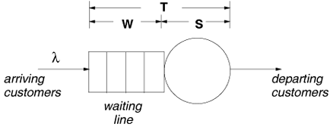
Single Queue
Single Server Systems
G/G/1 queue:
  “G”: the distribution of interarrival times of customers arriving to the system can be any generic distribution.
  “G” : the service time distribution of the single server is generic
  "1“: there is a single server

Slide 16
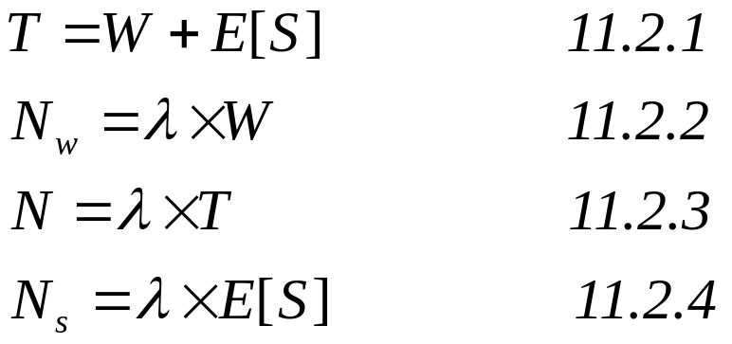
The G/G/1 queue-Equations1
T: Response time
N_{w}: Number of costumer in queue
N: Number of costumer in system
N_{s}: Number of costumer in server

Slide 17
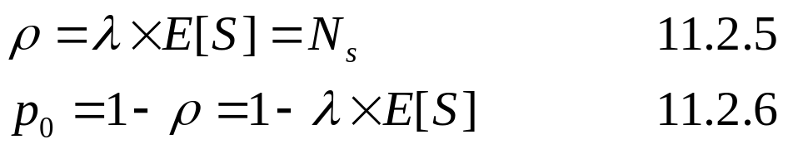
The G/G/1 queue-Equations2
ρ: Server Utilization
p₀: Server idle probability

Slide 18
Example 11.1
The average interarrival time of packets to a communication link is equal to 5 msec each packet takes 3 msec on average to be transmitted through the link.
  What is the utilization of the link?
  The average interarrival time is the inverse of the average arrival rate. λ = 1/5 = 0.2 packets/msec.
  From Eq. (11.2.5):
  ρ = 0.2 packets/msec x 3msec/packet = 60%.

Slide 19
Outline
11.1. Introduction
11.2. Single Queue Single Server Systems
11.3. The M/M/1 Queue
11.4. The M/G/1 Queue
11.5. M/G/1 with Vacations
11.6. M/G/1 with Priorities
11.7. Approximation Results
11.8. Concluding Remarks
11.9. Exercises
Bibliography

Slide 20
M/M/1
  A special case of the G/G/1 queue
  The "M" stands for Markovian or memoryless
  “M”: The interarrival times are exponentially distributed
  “M”: The service times are also exponentially distributed
  "1“: there is a single server

Slide 21
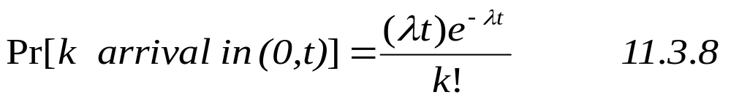
M/M/1 and Distributed Functions
The cumulative distribution function (CDF) of an exponentially distributed random variable X with parameter λ is given by
If interarrival times are exponentially distributed with parameter λ, then the probability of observing exactly k arrivals in a given time period from time 0 to time t is:

Slide 22
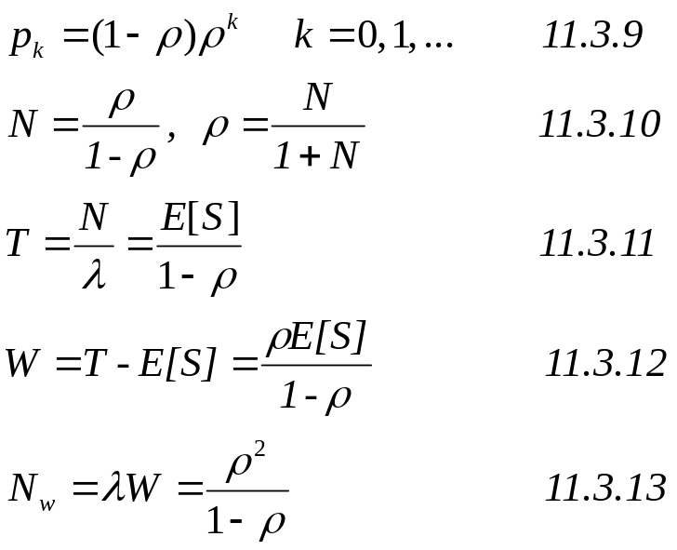
The M/M/1 queue
probability that there are k customers in the queuing
Number of customers in the system
Response time
Waiting time
Number of customers in the queue

Slide 23
Example 11.2
A file server receives requests from a Poisson process at a rate of 30 requests/sec.
Measurement data indicate that the coefficient of variation of the service time of a request at the file server is very close to 1. The average service time of a request is 15 msec.
  What is the average response time of a request at the file server?
  What would be the average response time if the arrival rate of requests were to double?

Slide 24
Example 11.2’
  Because the coefficient of variation of the service time is equal to 1, the service time is exponentially distributed.
  The utilization of the file server is ρ = λE[S] = 30 x 0.015 = 0.45.
  The average response time is T = E[S]/(1 –ρ) = 0.015/(1 – 0.45) = 0.027 sec.
  If the arrival rate increases to 60 requests/sec, the utilization becomes ρ = 60 x 0.015 = 0.90.
  The average response time increases to T = 0.015/(1 – 0.90) = 0.15 seconds.
  A two-fold increase in the arrival rate produces an increase in the average response time by a factor of 5.6 .

Slide 25
Outline
11.1. Introduction
11.2. Single Queue Single Server Systems
11.3. The M/M/1 Queue
11.4. The M/G/1 Queue
11.5. M/G/1 with Vacations
11.6. M/G/1 with Priorities
11.7. Approximation Results
11.8. Concluding Remarks
11.9. Exercises
Bibliography

Slide 26
The M/G/1 Queue
  “M”: The interarrival times are exponentially distributed
  “G” : the service time distribution of the single server is generic
  "1“: there is a single server

Slide 27
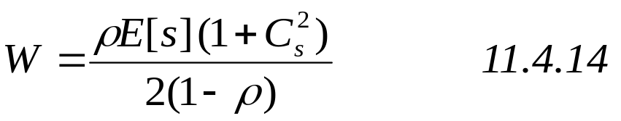
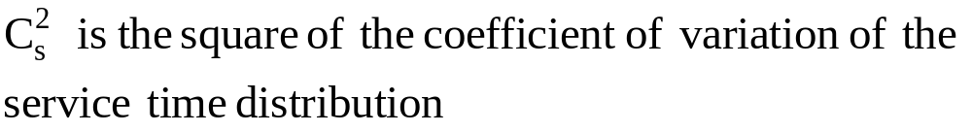
The M/G/1 queue
The Pollaczek-Khintchine (P-K) formula for the average waiting time W, [2] is:
if C_{s} = 1, the system is an M/M/1 queue

Slide 28
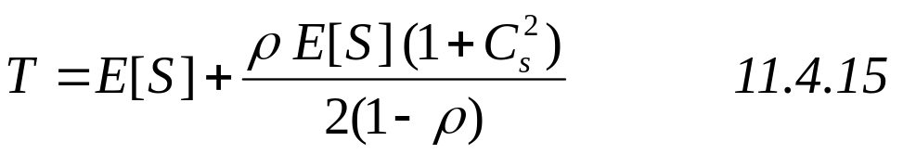
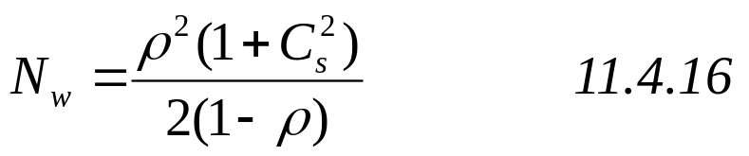
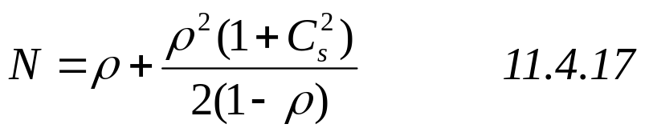
The M/G/1 queue
Response time:
Number of costumer in queue
Number of costumer in system

Slide 29
Example 11.3
E-mail messages arrive at an e-mail server from a Poisson process at a rate of 1.2 messages per second.
  30% of the messages are processed in 0.1 sec, 50% in 0.3 sec, and 20% in 2 sec.
  What is the average time E[S] it takes to process a message?

Slide 30

Example 11.3’
  What is the average time W a message waits in the queue to be processed?
  The utilization of the e-mail server is
  ρ=λ x E[S] = 1.2 x 0.58 = 0.696.
  For Cs:

Slide 31
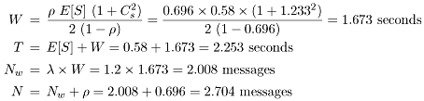
Example 11.3’’
  What is the average response time T of an e-mail message?
  What is the average number of messages N_{w} waiting in the queue?
  What is the average number of messages N in the e-mail server?

Slide 32
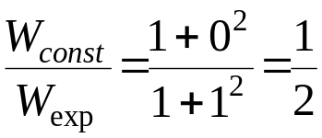
Example 11.4
What is the ratio between the average waiting time of an M/G/1 queue with exponentially distributed service times and the waiting time of an M/G/1 queue with constant service times?
  The coefficient of variation C_{s} of a server with an exponentially distributed service time is 1
  The coefficient of variation C_{s} of a server with an constant service time is 0.
  From equation 11.4.14:

Slide 33
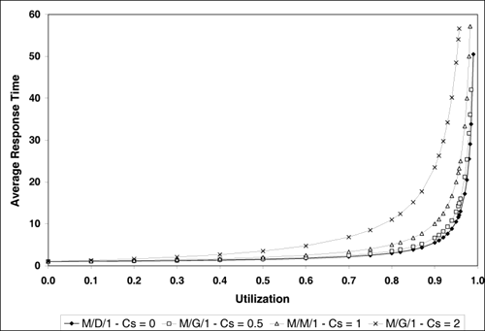
Figure 11.2. Response time of an M/G/1 queue for various values of Cs.
Figure shows various curves of the average response time versus utilization for an M/G/1 queue with E[S] = 1 for Cs: 0, 0.5, 1, and 2

Slide 34
Figure 11.2 Explanation
When C_{s} = 0, the M/G/1 queue is also referred to as an M/D/1 queue because service times are deterministic
When C_{s} = 1 service times are exponentially distributed and the resulting queue is an M/M/1 queue.
As illustrated in figure 11.2 and from Eq. (11.4.15), the average response time increases as a function of the square of the coefficient of variation of the service time.
Reducing the uncertainty (i.e., the standard deviation) of the service times placed on devices improves performance.

Slide 35
Outline
11.1. Introduction
11.2. Single Queue Single Server Systems
11.3. The M/M/1 Queue
11.4. The M/G/1 Queue
11.5. M/G/1 with Vacations
11.6. M/G/1 with Priorities
11.7. Approximation Results
11.8. Concluding Remarks
11.9. Exercises
Bibliography

Slide 36
M/G/1 with Vacations
The server goes on vacation for a time V as soon as the server becomes idle.
  The vacation time V is a random variable with any arbitrary distribution with average E[V] and second moment E[V²].
A customer that arrives to an empty system and finds the server on vacation has to wait until the server returns from vacation.
The server goes back to vacation if it returns from vacation to an empty system.

Slide 37
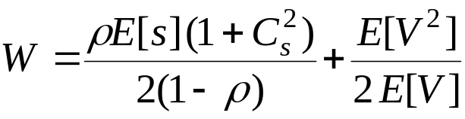
M/G/1 with Vacations
The average waiting time for an M/G/1 system with vacations
This equation can write also as follow:
11.5.18

Slide 38
M/G/1 with Work Conservation
  Work conserving: The server works non-stop as long as there are customers in the system
  The previous analysis of an M/G/1 queue assumes that the server is “work conserve”
  In some situations, the server may decide to take a break (say to get coffee) when the system is empty

Slide 39

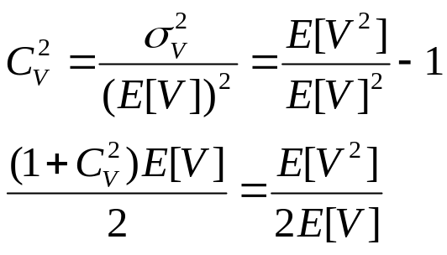
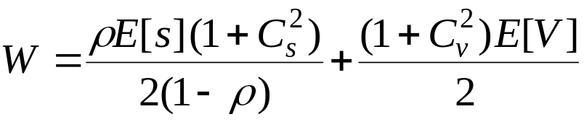
M/G/1 with Vacations’
Since,
Then: Equation 11.5.19
From 11.5.19

Slide 40
Example 11.5
A computer system serves requests that arrive from a Poisson process at a rate of 0.2 requests/sec.
The processing time characteristics of a request are E[S] = 3.5 sec and Cs = 0.3.
When there are no requests to be processed, the system performs a preventive maintenance procedure that lasts one second, on average, and has a coefficient of variation equal to 2.
When the maintenance procedure is complete, the system resumes to serve requests if there are any in the queue. Otherwise, the system starts another maintenance procedure.
What is the average waiting time of a request?

Slide 41

Example 11.5’
The value of ρ is 0.7 (= 0.2 x 3.5) and C_{v}=2. using Eq. (11.5.19):

Slide 42
Table 11.1. Variation of Waiting Time vs. Maintenance Time for example 11.5, Cs = 0.3
E[V] | M/G/1 no vacation | M/G/1 with vacation
0.0 | 4.45 | 4.45
0.5 | 4.45 | 5.70
1.0 | 4.45 | 6.95
1.5 | 4.45 | 8.20
2.0 | 4.45 | 9.45
2.5 | 4.45 | 10.70
3.0 | 4.45 | 11.95
3.5 | 4.45 | 13.20
4.0 | 4.45 | 14.45
4.5 | 4.45 | 15.70
5.0 | 4.45 | 16.95
5.5 | 4.45 | 18.20
6.0 | 4.45 | 19.45

Slide 43
Outline
11.1. Introduction
11.2. Single Queue Single Server Systems
11.3. The M/M/1 Queue
11.4. The M/G/1 Queue
11.5. M/G/1 with Vacations
11.6. M/G/1 with Priorities
11.7. Approximation Results
11.8. Concluding Remarks
11.9. Exercises
Bibliography

Slide 44
M/G/1 with Priorities
Many computer systems assign different priorities to the incoming requests
E.g., operating systems and communication systems
The different waiting lines are used by requests of different priorities.
Customers are classified into P different static priorities before arriving into the system.
Upon arrival, customers join the waiting line that corresponds to their priority class.
λ₁
λ₂
λ_{p}

Slide 45
M/G/1 with Priorities’
Priority classes are numbered from 1 to P with P being the highest priority class and 1 being the lowest
The arrival rate of requests of priority p (p = 1, ···, P) is denoted by λ_{p}.
The average service time and second moment of class p requests are denoted by E[S_{p}] and E[S_{p}²] respectively
λ₁
λ₂
λ_{p}

Slide 46
Priority Strategy
There is two strategy for processing in the server
Non-preemptive: Once service begins on a request it is not interrupted until the request is completed, even if a request of higher priority than the one in service arrives.
Preemptive resume: If a request of priority p arrives and finds a request of priority q (q < p) being served, the higher priority request seizes the server.
  Once there are no more requests of priority higher than q, the preempted request resumes its processing from the point at which it was interrupted.

Slide 47



Non-Preemptive Priorities
The waiting time:
  Where:
  And W₀ is the average time an arriving request has to wait for the server to complete processing the current request in service
The product λ_{j}*E[S_{j}] is the utilization ρ_{j} due to priority j requests
11.6.20
11.6.22
11.6.21

Slide 48

Non-Preemptive Priorities’
The total utilization ρ is then
The average response time of priority class p requests:
T_{p} = W_{p} + E[S_{p}]
11.6.23

Slide 49
Example 11.6
A router receives packets at a rate of 1.2 packets/msec from a Poisson process. All packets are transmitted through the same outgoing link. 50% percent of the packets are of priority 1, 30% percent are of priority 2, and 20% percent are of priority 3. The mean and second moment of the packet transmission times are as shown in table 11.2
What is the average waiting time per packet class?
Priority (p) | E[S_{P}] msec | E[S_{p}²] msec²
1 | 0.5 | 0.375
2 | 0.4 | 0.400
3 | 0.3 | 0.180
Table 11.2

Slide 50
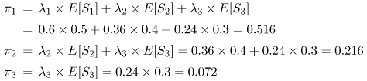

Example 11.6’
The arrival rates per class are:
  λ₁ = 1.2 x 0.50 = 0.6 packets/msec
  λ₂ = 1.2 x 0.3 = 0.36 packets/msec
  λ₃ = 1.2 x 0.2 = 0.24 packets/msec.
  from Eq. (11.6.22):
  from Eq. (11.6.21):

Slide 51
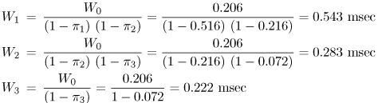
Example 11.6’’
from Eq. (11.6.20):
  The average response times for each priority class are
  T1 = W1 + E[S1] = 0.543 + 0.5 = 1.043 msec
  T2 = W2 + E[S2] = 0.283 + 0.4 = 0.683 msec
  T3 = W3 + E[S3] = 0.222 + 0.3 = 0.522 msec

Slide 52
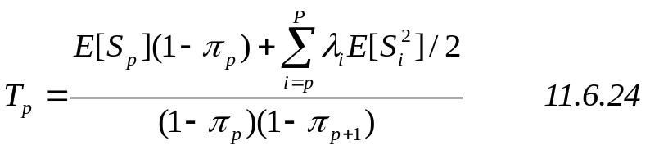
Preemptive Resume Priorities
The average response time T_{p}:
Classes of priority lower than p are not represented in Eq. (11.6.24) because of requests of a lower priority have no impact on higher priority requests

Slide 53
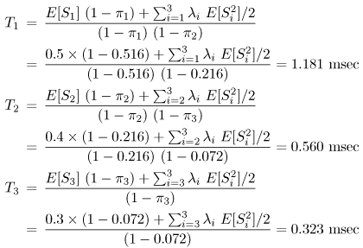
Example 11.7
Assume the same data of the previous example and assume a preemptive resume server. What are the average response times of each customer class? By Equation (11.6.24):

Slide 54
Outline
11.1. Introduction
11.2. Single Queue Single Server Systems
11.3. The M/M/1 Queue
11.4. The M/G/1 Queue
11.5. M/G/1 with Vacations
11.6. M/G/1 with Priorities
11.7. Approximation Results
11.8. Concluding Remarks
11.9. Exercises
Bibliography

Slide 55
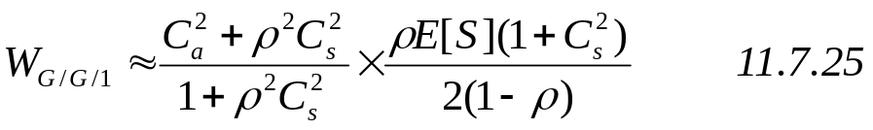
The G/G/1 Queue
In this case some approximations are used
The waiting time for G/G/1 queue is estimated:
C_{a} is the coefficient of variation of the interarrival time.
For C_{a} = 1 this approximation is exact for M/G/1.

Slide 56


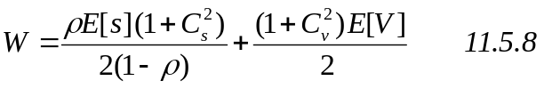
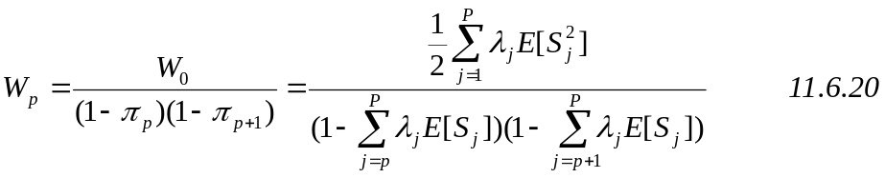
Summary
The M/M/1 queue
The M/G/1 queue
M/G/1 with Vacations
M/G/1 Non-Preemptive Priorities
M/G/1 Preemptive Priorities
G/G/1 Queue

Slide 57
Example 11.8
Measurements taken from a storage device used by a database server indicate that I/O requests arrive at an average rate of 80 requests/sec.
The standard deviation of the interarrival time is measured as 0.025 sec.
The average I/O time is measured as 0.009 sec with a standard deviation of 0.003 sec.
What is the approximate waiting time of an I/O request at the storage device?

Slide 58

Example 11.8’
The average interarrival time is:
The coefficient of variation of the interarrival time is :
C_{a} = 0.025/0.0125 = 2
The utilization of the storage device :
ρ = λ x E[S] = 80 x 0.009 = 0.72
The coefficient of variation of the service time
C_{s} = 0.003/0.009 = 1/3

Slide 59
Example 11.8’’
And for the average waiting time at the storage device we can use Equation (11.7.25)

Slide 60
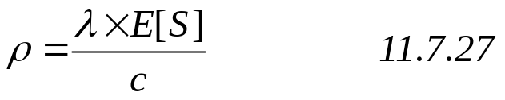
The G/G/c queue
There is c identical servers and a single waiting line.
Utilization:
1
2
c

Slide 61


The G/G/c queue’
The exact solution for G/G/c is not known. The average waiting time can be approximated by:
Where:
( Erlang's C formula)
11.7.28
11.7.29

Slide 62

The M/M/c queue’’
This a special case of G/G/C
With C_{s}=1 and C_{a}=1
By inserting C_{s}=1 and C_{a}=1 in equation 11.7.28:
11.7.30

Slide 63
Example 11.9
A computer system receives requests that require an average of 2 seconds of service time.
The coefficient of variation of the service time is 0.5 and the coefficient of variation of the interarrival time is 0.8.
What is the minimum number of processors that should be used to keep the average response time below 2.5 seconds when the utilization of the system is 80%?

Slide 64
Example 11.9’
using the G/G/c approximation of Eq. (11.7.28).
ρ = 0.80, C_{a} = 0.8, C_{s} = 0.5, and E[S] = 2 sec.
Table 11.3. Response Time (sec) vs. No. Processors
No. Processors | Avg. Response Time (sec)
1 | 5.56 (1)
2 | 3.58 (2.78)
3 | 2.96 (1.85)
4 | 2.66 (1.39)
5 | 2.49 (1.11)
6 | 2.38 (0.93)
7 | 2.31 (0.79)
8 | 2.25 (0.7)

Slide 65
Outline
11.1. Introduction
11.2. Single Queue Single Server Systems
11.3. The M/M/1 Queue
11.4. The M/G/1 Queue
11.5. M/G/1 with Vacations
11.6. M/G/1 with Priorities
11.7. Approximation Results
11.8. Concluding Remarks
11.9. Exercises
Bibliography

Slide 66
Concluding Remarks
Single queue systems provide useful information when estimating waiting times due to contention for shared resources.
The M/G/1 queue is one of the most studied queuing systems. A large number of results are available, including vacationing servers and different priority scheduling schemes.
Approximate results for G/G/1 and G/G/c are also given. The following chapters consider networks of queues, where individual queues are interconnected

Slide 67
Outline
11.1. Introduction
11.2. Single Queue Single Server Systems
11.3. The M/M/1 Queue
11.4. The M/G/1 Queue
11.5. M/G/1 with Vacations
11.6. M/G/1 with Priorities
11.7. Approximation Results
11.8. Concluding Remarks
11.9. Exercises
Bibliography

Slide 68
Exercises 1-3
Show that in a G/G/1 queue, the average number of customers at the server is equal to the utilization of the server.
Derive Eqs. (11.3.9) and (11.3.11) using the Generalized Birth-Death theorem.
Derive the average waiting time for M/M/1 from Eq. (11.7.30).

Slide 69
Exercises 4
Consider two Web clusters, A and B. Cluster A has n servers and cluster B has m (m > n) servers. Requests arrive at each cluster at a rate of l requests/sec. A load balancer in front of each cluster evenly distributes the requests to each server in the cluster. The average service time of a request in cluster A is x seconds and the average service time of a request in cluster B is k x x where k > 1. The service time of a request in either cluster has an arbitrary distribution. Derive an expression for the value of m so that the average response of a request in cluster A is the same as in cluster B.

Slide 70


Exercises 5
A computer system receives requests from a Poisson process at a rate of 10 requests/sec. Assume that 30% of the requests are of type a and the remaining are of type b. The average service times and the coefficients of variation of the service times for these two types of requests are: E[Sa] = 0.1 seconds, , E[Sb] = 0.08 seconds, and . Compute the average response time for each type of request under each of the following scenarios: 1) requests of type a and b have equal priorities, 2) requests of type a have non-preemptive priority over requests of type b, 3) requests of type b have non-preemptive priority over requests of type a, 4) requests of type a have preemptive priority over requests of type b, and 5) requests of type b have preemptive priority over requests of type a.

Slide 71
Exercises 6
Consider the class 3 requests in Example 11.7 when the server uses a preemptive resume scheduling policy (see Section 11.6.2). It is stated the performance (i.e., the waiting time) of the highest priority requests (i.e., class 3 in this case) is not affected by the lower priority requests. Prove this statement by computing the waiting time of class 3 requests using vanilla M/G/1 results (i.e., from Section 11.4). Compare the result to the value computed in Section 11.6.2.

Slide 72
Bibliography
[1] D. Gross and C. M. Harris, Fundamentals of Queueing Theory, 3rd ed., Wiley-Interscience, 1998.
[2] L. Kleinrock, Queueing Systems, Vol I: Theory, John Wiley & Sons, New York, 1975.
[3] L. Kleinrock, Queueing Systems, Vol II: Computer Applications, John Wiley & Sons, New York, 1976.
[4] R. Nelson, Probability, Stochastic Processes, and Queuing Theory: The Mathematics of Computer Performance Modelling, Springer Verlag, New York, 1995.

Slide 73
Outline
11.1. Introduction
11.2. Single Queue Single Server Systems
11.3. The M/M/1 Queue
11.4. The M/G/1 Queue
11.5. M/G/1 with Vacations
11.6. M/G/1 with Priorities
11.7. Approximation Results
11.8. Concluding Remarks
11.9. Exercises
Bibliography

Slide 74
Pallazek-Khinchin Formula
A proof

Slide 75
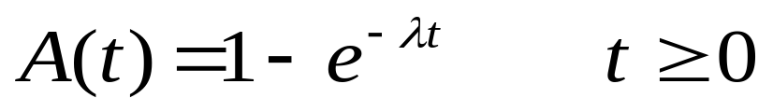
M/G/1
Interarrival time distribution:

Slide 76






Definitions
Represents the nth customer to enter the system
Arrival time of C_{n}
Interarrival time between C_{n} -1 and C_{n}
Service time for C_{n}
Number of customers left behind by departure of C_{n} from service
Number of customers arriving during the service of C_{n}

Slide 77

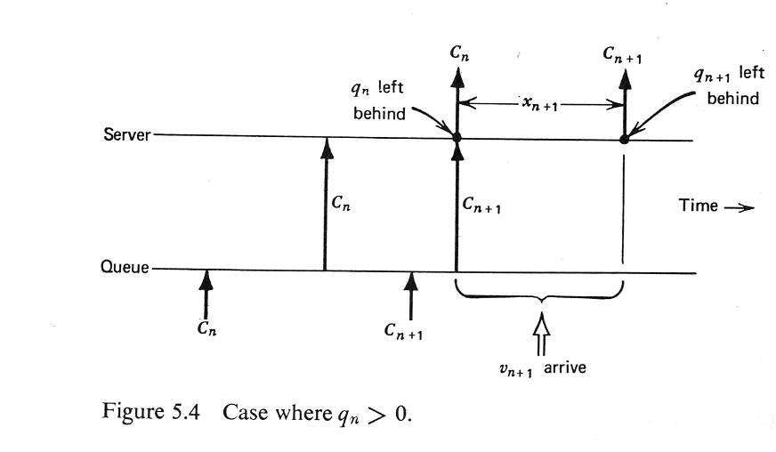
M/G/1 queue
We want to find the number of customers left behind before when Cn+1 departs
According to figure:
5.31

Slide 78

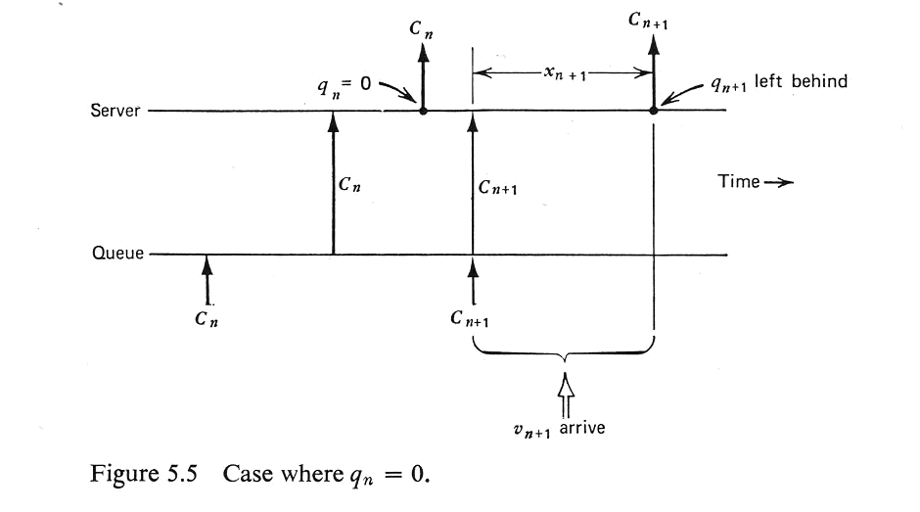
M/G/1 queue
And q_{n}=0, means empty system
According to figure:
5.32

Slide 79
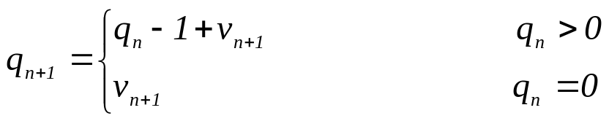
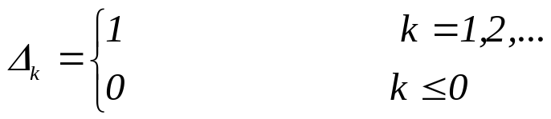

M/G/1 queue
The last two equations can be written as:
And By the definition of the shifted step function:
q_{n+1} is:
5.33
5.34
5.35

Slide 80
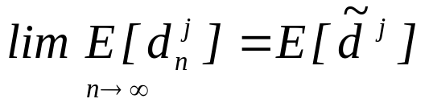


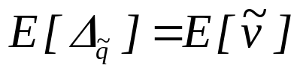
M/G/1 queue
q
Definition:
By forming the expectation in both sides of Eq. 3.35 and then taking the limit as
And then:
5.36
5.37

Slide 81
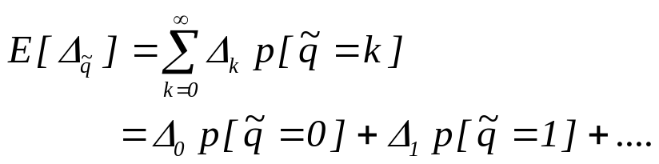

M/G/1 queue
The left side of Eq 5.37:
By equation 5.37 and 5.38:
It means that the average number of arrivals in a service time is equal to utilization
5.38
5.41

Slide 82

M/G/1 queue
By first squaring Eq 5.35 and then taking expectation:
Interarivials during n+1 service time is independent of the number of costumers left behind by Cn. Then the last two equations may each be written as a product of the expectations.
We also know:
Taking the limit as n goes to infinity:

Slide 83
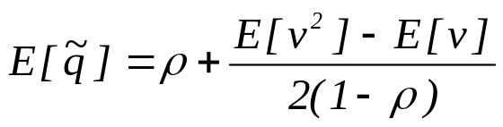

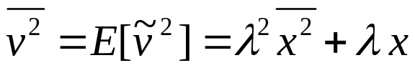
M/G/1 queue
Now using the equation 5.37 and 5.41 we have:
We have also two important relations that we will prove them later:
5.43
5.58
5.61

Slide 84
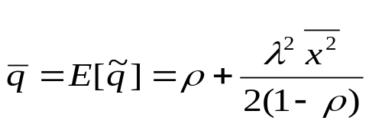


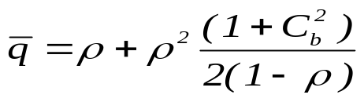
M/G/1 queue
By Eqs. 5.43, 5.58 and 5.61 we have:
By replacing:
And
We can write:
This is the average number of customers in an M/G/1 system Pollaczek-Khinchin (p-k) mean value formula.
5.63

Slide 85
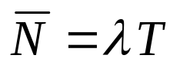
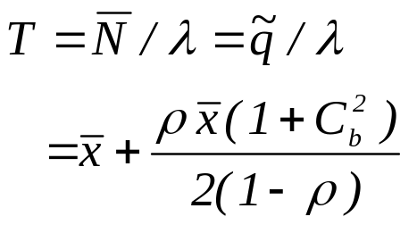
Response time
Now by little law:
And the response time is:
5.69

Slide 86
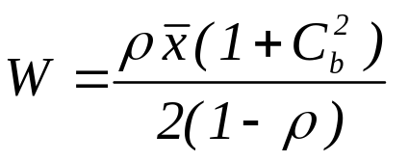

Waiting time
For calculating the waiting time we can subtract response time from service time and we have:
5.69
, S : service time

Slide 87
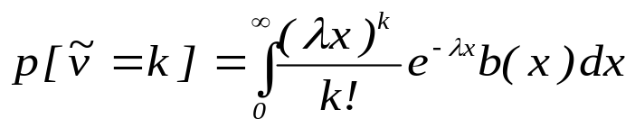
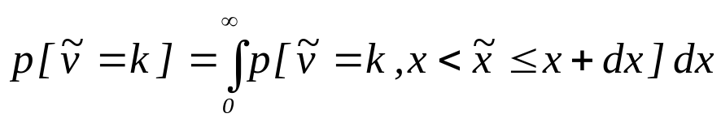
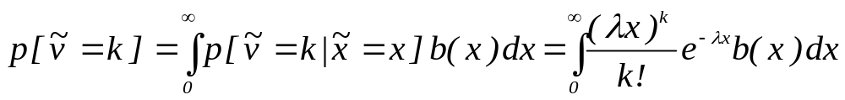
Proving the equations 5.58 and 5.61
Before proving the equations we will prove the following relation:
Where b(x) is the distribution of service time
We can write:
And by conditional probability:

Slide 88

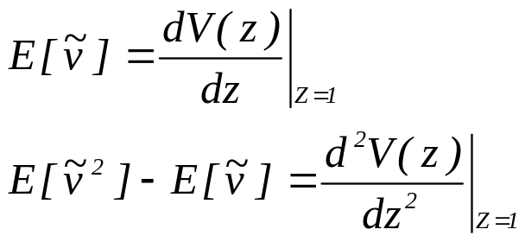
Proving the equations 5.58 and 5.61
We want to compute the first moment and secon moment of
Using the z-transform we can do that:
So we must determine the z-transform of

Slide 89
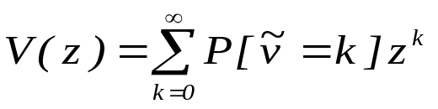
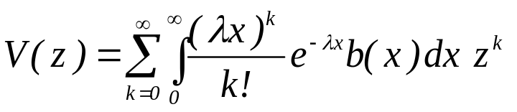
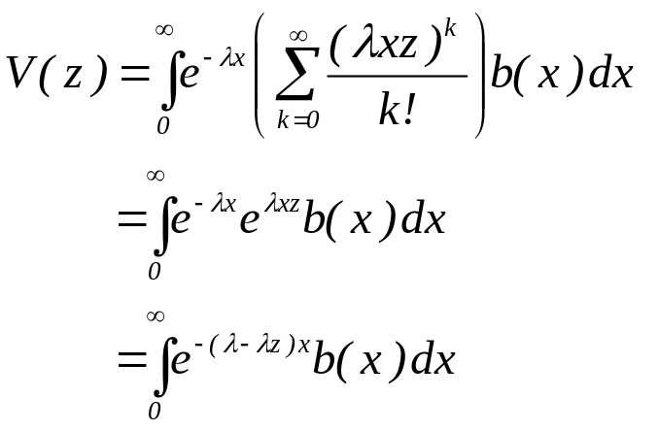
Proving the equations 5.58 and 5.61
By definition we have:
And replacing the probability by its definition and using 5.28 we have:

Slide 90
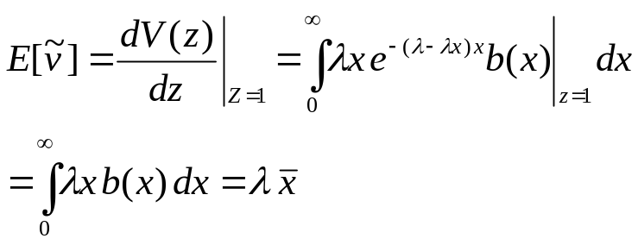
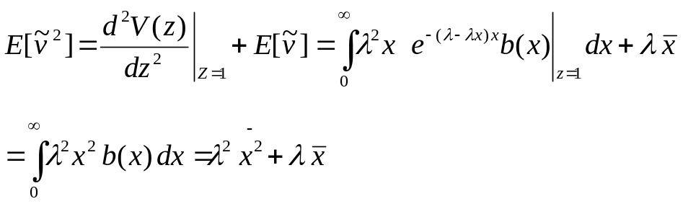
Proving the equations 5.58 and 5.61
Now we can compute the moments:
And the relations have been proved

